Slide 1





Fundamentals of Databases
Notes:
Welcome to the foundation course.
In the first module we'll learn about operating systems.
Among operating systems, Linux based operating systems are the most used operating systems.
So, let's understand what is Linux and how's it different from other operating systems.

Slide 2
Disclaimer
The content is curated from online/offline resources and used for educational purpose only

Slide 3

Learning Objectives
To understand the concepts of DBMS.
To understand the concepts of RDBMS.
To get a practical hands-on experience of the concepts of RDBMS.
Notes:
Learning Objectives
At the end of this course. You will be able to:
To understand the concepts of DBMS.
To understand the concepts of RDBMS.
To get a practical hands-on experience of the concepts of DBMS.

Slide 4

Scenario
An imaginative scenario:
Once upon a time, in a bustling office filled with stacks of paper, a small business named "PaperWorks Co." was struggling to keep up with its growing list of customers, orders, and products. Every time they needed to find an order or update customer information, they had to search through piles of documents and folders. It was a real mess!
A new employee, Sarah, joins the company. She would like to help but don’t know how. How can you help?
Source:
https://th.bing.com/th/id/OIP.uhqnL_P82sFw9_RVWMGvdAHaEK?w=331
Notes:
Scenario
Before moving into technical part, think of this imaginative scenario.
Once upon a time, in a bustling office filled with stacks of paper, a small business named "PaperWorks Co." was struggling to keep up with its growing list of customers, orders, and products. Every time they needed to find an order or update customer information, they had to search through piles of documents and folders. It was a real mess!
A new employee, Sarah, joins the company. How can you help?
************Note to trainer: Ask students about their take and solution to the problem****************
************Note to trainer: Explain how Sarah discovers DBMS. Solution to the problem***************
Sarah discovered that a DBMS was like a digital organizer, a way to put all their important information into neat virtual containers. She explained to her colleagues how DBMS could help:
Easy Access and Organization: With DBMS, they wouldn't have to hunt for papers anymore. They could put everything into tables with clear labels, just like sorting papers into different folders. Finding information would be a breeze.
No More Clutter: Sarah explained that DBMS would prevent them from making multiple copies of the same information. Instead of having endless spreadsheets, they could have one reliable source of truth. This would save space and keep data consistent.
Digital Locks: Sarah mentioned how they could use the DBMS to set permissions. Only authorized people could access certain parts of the data. It was like adding locks to sensitive file drawers.
Smooth Collaboration: Sarah shared how DBMS would let everyone work on the same data at the same time without stepping on each other's toes. No more worrying about someone accidentally messing up the spreadsheets.
Quick Changes and Insights: Sarah demonstrated how DBMS could easily correct mistakes and generate reports with just a few clicks. They could analyze sales data, customer trends, and much more in a flash.
Looking at all these amazing advantages made by Sarah, the company decided to use DBMS. In this module, we will learn about DBMS, so you can use DBMS is your future projects as well.

Slide 5

Contents
In this section we are going to discuss about:
Introduction to DBMS.
Introduction to RDBMS
Installing MySQL
Using MySQL queries
Source:
https://www.freepik.com/premium-vector/content-marketing-landing-page_6324893.htm#
Notes:
Contents
In this section we are going to discuss about:
Introduction to DBMS.
Introduction to RDBMS
Installing MySQL
Using MySQL queries

Slide 6
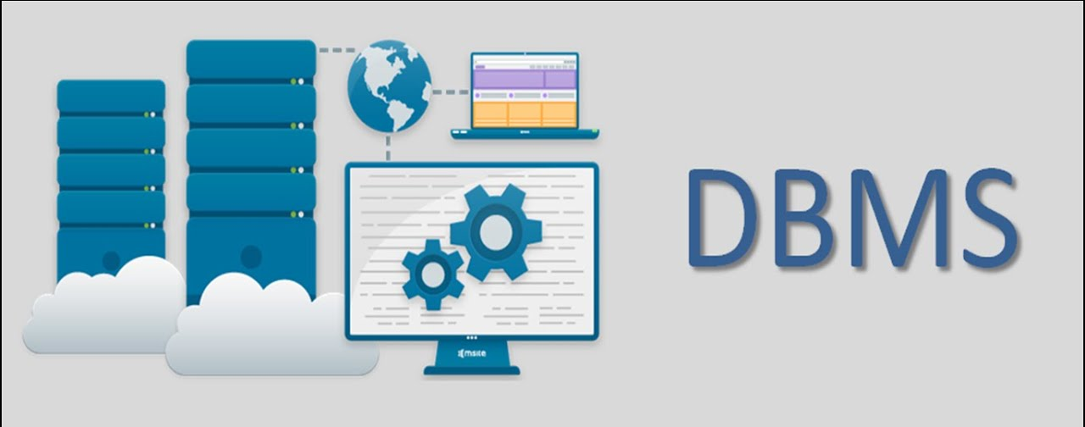
Introduction
Data is defined as a collection of facts and figures that can be recorded and has implicit meaning.
DBMS stands for Database Management System.
DBMS is a collection of inter-related data and set of programs to store & access those data in an easy and effective manner.
Inter-related data can be in the form of Phone Book, Shopping list etc., and Database can be stored in different ways such as On paper, On a computer, This PowerPoint etc.
Source:
https://i.ytimg.com/vi/lDpB9zF8LBw/maxresdefault.jpg
Notes:
Introduction:
Data is defined as a collection of facts and figures that can be recorded and has implicit meaning.
Database is a collection of related data.
DBMS stands for Database Management System. We can break it like this DBMS = Database + Management System. Database is a collection of data and Management System is a set of programs to store and retrieve those data. Based on this we can define DBMS like this: DBMS is a collection of inter-related data and set of programs to store & access those data in an easy and effective manner.
Inter-related data can be in the form of Phone Book, Shopping list etc., and Database can be stored in different ways such as On paper, On a computer, This PowerPoint etc.

Slide 7
Why use a Database?
Databases can store very large numbers of records efficiently
It is very quick and easy to find information.
It is easy to add new data and to edit or delete old data.
Data can be searched & Sorting easily,
Data can be imported into other applications
More than one person can access the same database at the same time - multi-access.
Security may be better than in paper files.
Notes:
Why uses a database ?
There are multiple reasons behind it such as :
Databases can store very large numbers of records efficiently
It is very quick and easy to find information.
It is easy to add new data and to edit or delete old data.
Data can be searched & Sorting easily,
Data can be imported into other applications
More than one person can access the same database at the same time - multi-access.
Security may be better than in paper files.

Slide 8
Why do we need a Database?
Manages large amounts of data
Accurate
Easy to update data
Security of data
Data integrity
Easy to research data
Notes:
Why do we need a database?
Manages large amounts of data
A database stores and manages a large amount of data on a daily basis. This would not be possible using any other tool such as a spreadsheet as they would simply not work.
Accurate
A database is pretty accurate as it has all sorts of build in constraints, checks etc. This means that the information available in a database is guaranteed to be correct in most cases.
Easy to update data
In a database, it is easy to update data using various Data Manipulation languages (DML) available. One of these languages is SQL.
Security of data
Databases have various methods to ensure security of data. There are user logins required before accessing a database and various access specifiers. These allow only authorised users to access the database.
Data integrity
This is ensured in databases by using various constraints for data. Data integrity in databases makes sure that the data is accurate and consistent in a database.
Easy to research data
It is very easy to access and research data in a database. This is done using Data Query Languages (DQL) which allow searching of any data in the database and performing computations on it.

Slide 9
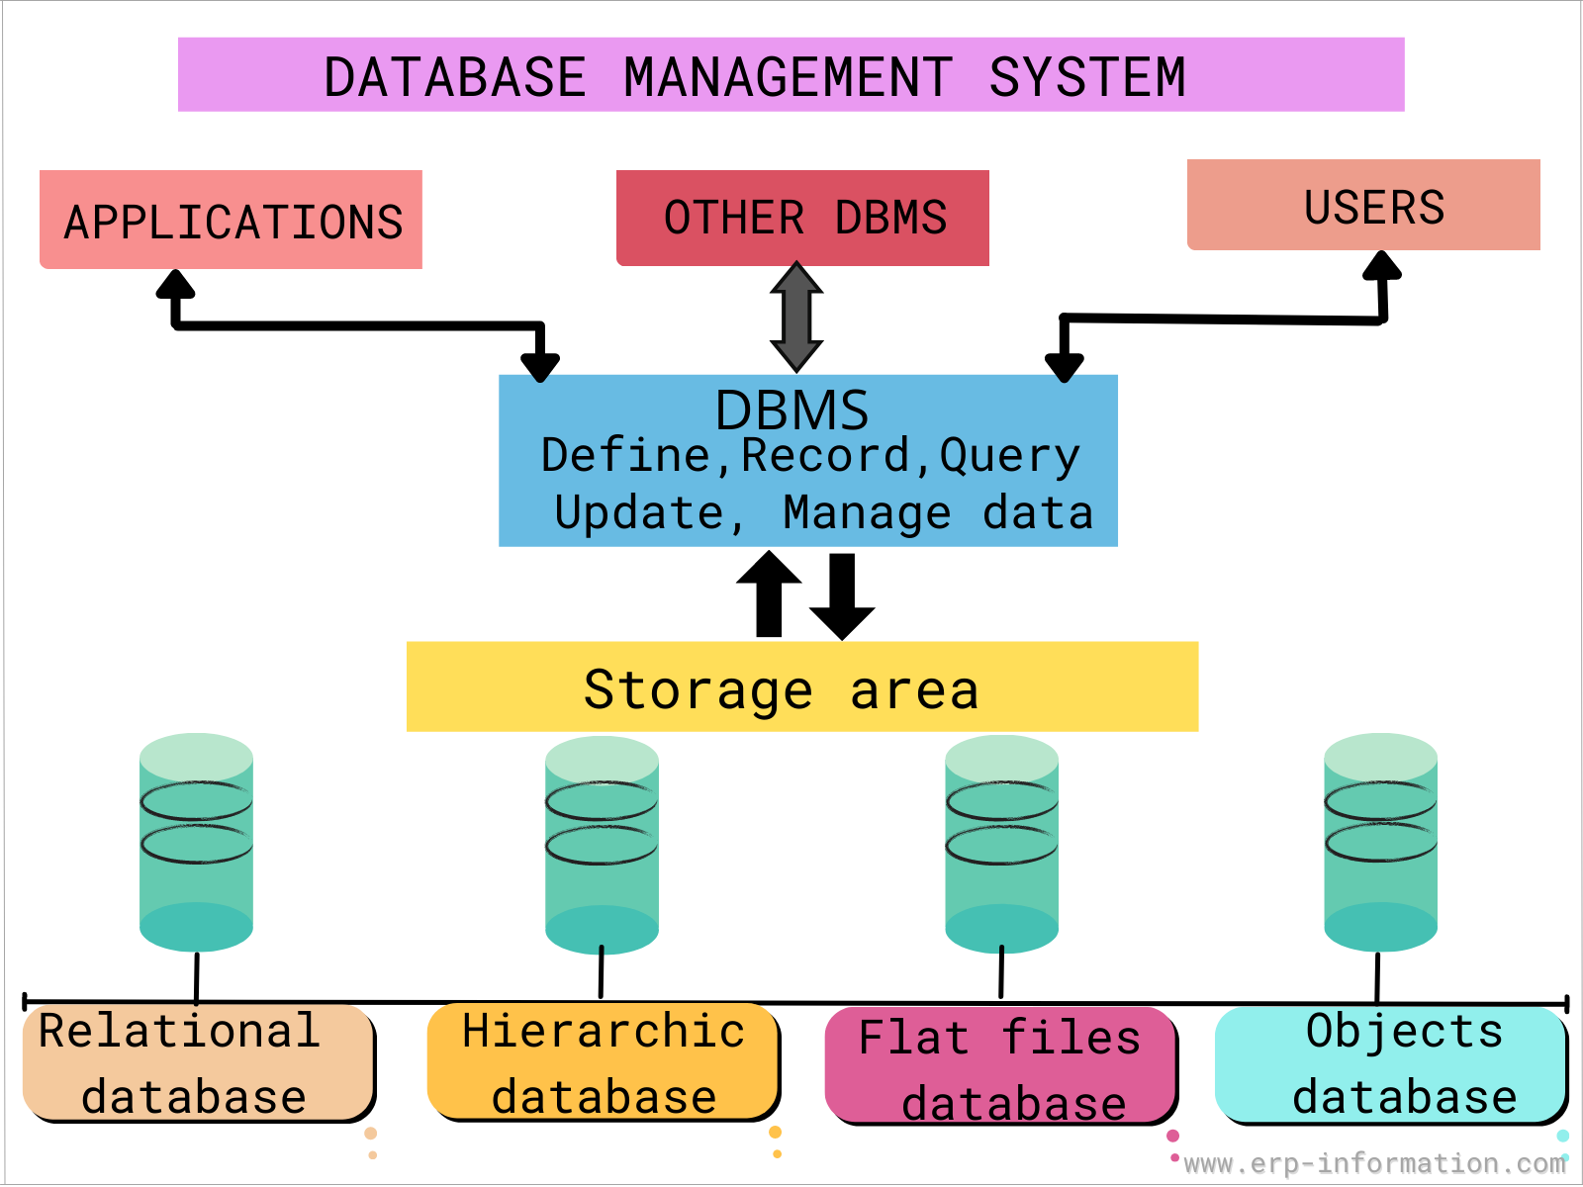
DBMS: in Detail
Database management system is a software which is used to manage the database.
DBMS provides an interface to perform various operations like database creation, storing data in it, updating data, creating a table in the database and a lot more.
It provides protection and security to the database. In the case of multiple users, it also maintains data consistency.
Source:
database-management.png (1600×1200) (erp-information.com)
Notes:
DBMS: in detail
Database management system is a software which is used to manage the database. For example: MySQL, Oracle, etc are a very popular commercial database which is used in different applications.
DBMS provides an interface to perform various operations like database creation, storing data in it, updating data, creating a table in the database and a lot more.
It provides protection and security to the database. In the case of multiple users, it also maintains data consistency.

Slide 10
DBMS allows users the following Tasks
Data Definition
Data Updation
Data Retrieval
User Administration
Notes:
DBMS allows users the following tasks:
Data Definition: It is used for creation, modification, and removal of definition that defines the organization of data in the database.
Data Updation: It is used for the insertion, modification, and deletion of the actual data in the database.
Data Retrieval: It is used to retrieve the data from the database which can be used by applications for various purposes.
User Administration: It is used for registering and monitoring users, maintain data integrity, enforcing data security, dealing with concurrency control, monitoring performance and recovering information corrupted by unexpected failure.

Slide 11
Characteristics of DBMS
It uses a digital repository established on a server to store and manage the information.
It can provide a clear and logical view of the process that manipulates data.
DBMS contains automatic backup and recovery procedures.
It contains ACID properties which maintain data in a healthy state in case of failure.
It can reduce the complex relationship between data.
It is used to support manipulation and processing of data.
It is used to provide security of data.
It can view the database from different viewpoints according to the requirements of the user.
Notes:
Characteristics of DBMS
It uses a digital repository established on a server to store and manage the information.
It can provide a clear and logical view of the process that manipulates data.
DBMS contains automatic backup and recovery procedures.
It contains ACID properties which maintain data in a healthy state in case of failure.
It can reduce the complex relationship between data.
It is used to support manipulation and processing of data.
It is used to provide security of data.
It can view the database from different viewpoints according to the requirements of the user.

Slide 12
Advantages of DBMS
Controls database redundancy
Data sharing
Easily Maintenance
Reduce time
Backup
Multiple user interface
Notes:
Advantages of DBMS
Controls database redundancy: It can control data redundancy because it stores all the data in one single database file and that recorded data is placed in the database.
Data sharing: In DBMS, the authorized users of an organization can share the data among multiple users.
Easily Maintenance: It can be easily maintainable due to the centralized nature of the database system.
Reduce time: It reduces development time and maintenance need.
Backup: It provides backup and recovery subsystems which create automatic backup of data from hardware and software failures and restores the data if required.
multiple user interface: It provides different types of user interfaces like graphical user interfaces, application program interfaces

Slide 13
Disadvantages of DBMS
Cost of Hardware and software
Size
Complexity
Higher impact of failure
Notes:
Disadvantages of DBMS
Cost of Hardware and Software: It requires a high speed of data processor and large memory size to run DBMS software.
Size: It occupies a large space of disks and large memory to run them efficiently.
Complexity: Database system creates additional complexity and requirements.
Higher impact of failure: Failure is highly impacted the database because in most of the organization, all the data stored in a single database and if the database is damaged due to electric failure or database corruption then the data may be lost forever.

Slide 14
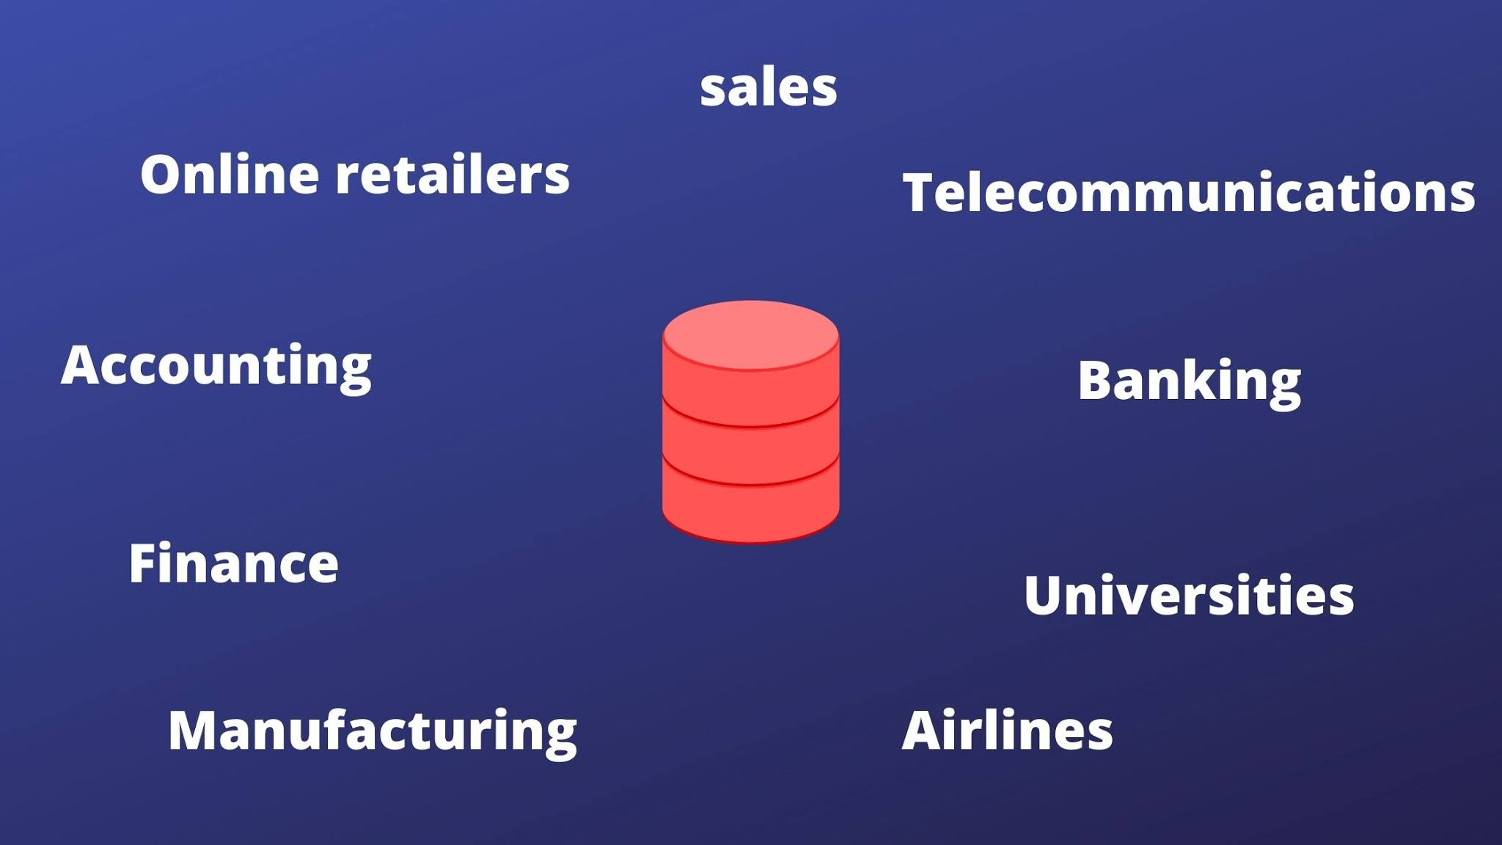
Application of DBMS
Source:
https://www.thecscience.com/2021/07/DBMS-applications.html
Notes:
DBMS applications
Applications where we use Database Management Systems are:
Telecom: There is a database to keeps track of the information regarding calls made, network usage, customer details etc. Without the database systems it is hard to maintain that huge amount of data that keeps updating every millisecond.
Industry: Where it is a manufacturing unit, warehouse or distribution centre, each one needs a database to keep the records of ins and outs. For example distribution centre should keep a track of the product units that supplied into the centre as well as the products that got delivered out from the distribution centre on each day; this is where DBMS comes into picture.
Banking System: For storing customer info, tracking day to day credit and debit transactions, generating bank statements etc. All this work has been done with the help of Database management systems. Also, banking system needs security of data as the data is sensitive, this is efficiently taken care by the DBMS systems.
Sales: To store customer information, production information and invoice details. Using DBMS, you can track, manage and generate historical data to analyse the sales data.
Airlines: To travel though airlines, we make early reservations, this reservation information along with flight schedule is stored in database. This is where the real-time update of data is necessary as a flight seat reserved for one passenger should not be allocated to another passenger, this is easily handled by the DBMS systems as the data updates are in real time and fast.
Education sector: Database systems are frequently used in schools and colleges to store and retrieve the data regarding student details, staff details, course details, exam details, payroll data, attendance details, fees details etc. There is a large amount of inter-related data that needs to be stored and retrieved in an efficient manner.
Online shopping: You must be aware of the online shopping websites such as Amazon, Flipkart etc. These sites store the product information, your addresses and preferences, credit details and provide you the relevant list of products based on your query. All this involves a Database management system. Along with managing the vast catalogue of items, there is a need to secure the user private information such as bank & card details. All this is taken care of by database management systems.

Slide 15
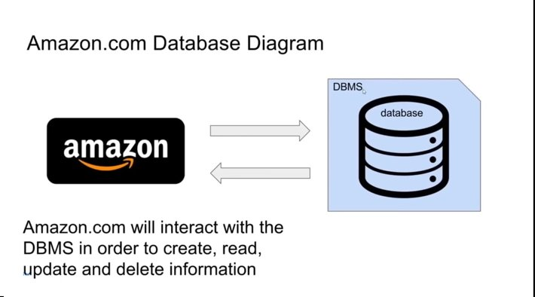
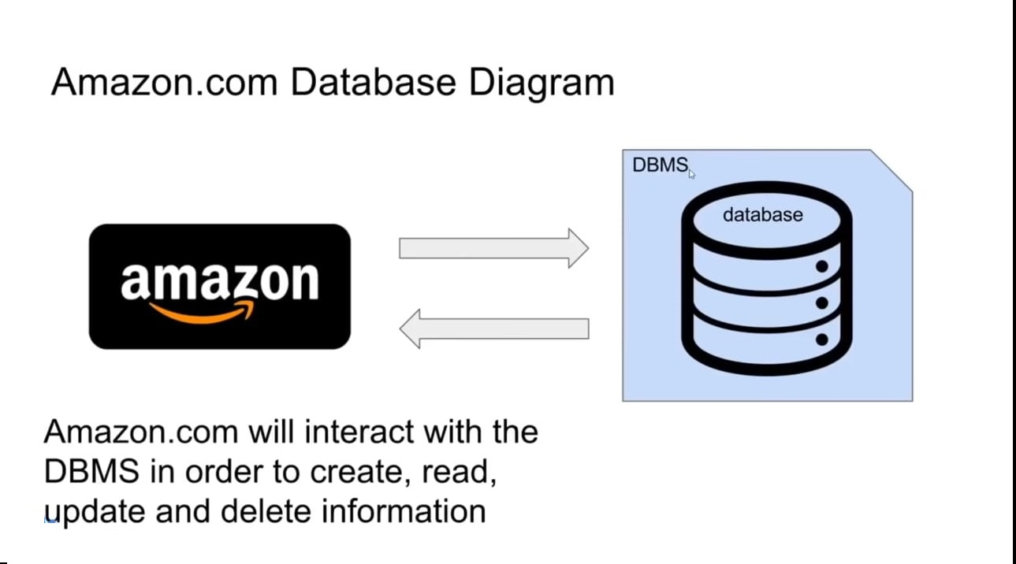
Example for DBMS
Source:
https://youtu.be/HXV3zeQKqGY?si=ULWXLbHW-OlVDbOj
Notes:
You're going to be using a database to store huge amounts of information, So, if you're a company like Amazon and you have trillions of pieces of information that you need to keep track of, well the database management system can make it easy for you to store trillions of pieces of information, right?
It's not like all that information is just in like some single text file. The database management system will make it easy for you to store that.
Database management systems can also handle security.So,they can make it so only certain people with the usernames and passwords can access the data.
It'll also help you to backup your data and import and export data from other sources.So,if you have a bunch of information and you want to back it up, Database management systems can also interact with software applications.
Amazon.com is a website. And it's interacting with the Amazon database. Which is stored mostly likely using a database management system.
Write a program that could interact with the database management system. All right, so let's look at this quite little diagram that I have here.And the Amazon is communicating with a database management system.
The database management system is creating and storing and keeping track of a database.

Slide 16


Database Queries
Queries are requests made to the database management system for specific information.
As the database’s structure become more and more complex, it becomes more difficult to get the specific pieces of information we want.
A Google/Bing search is a query.
Source:
https://www.flaticon.com/search?word=queries
Notes:
I want to discuss about some core concepts within databases. Database Queries.
Queries are requests made to the database management system for specific information and generally, a query is you’re asking the DBMS.
As the database’s structure become more and more complex, it becomes more difficult to get the specific pieces of information we want. If you have a very complex database layout or schema, then getting a specific piece of information can be tricky.
A google or Bing search is a query. If I go on a search engine and I would generally type in the specific information that I want, then serach engine would give me the information that matches that search query.

Slide 17

RDBMS
Notes:
Now let's talk about a very important concept in DBMS called as RDBMS.

Slide 18
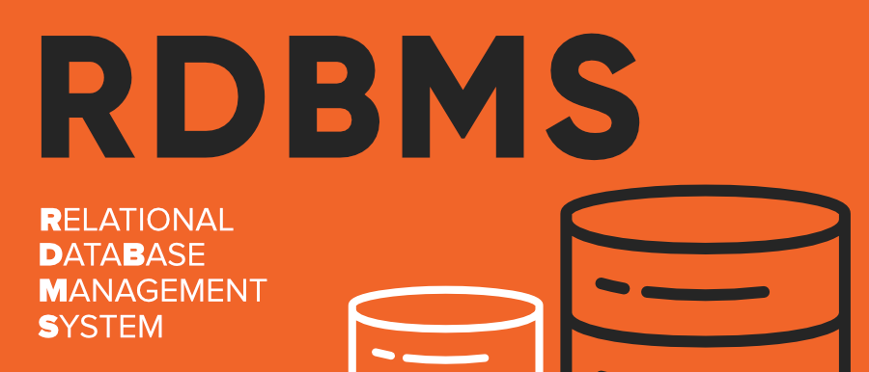
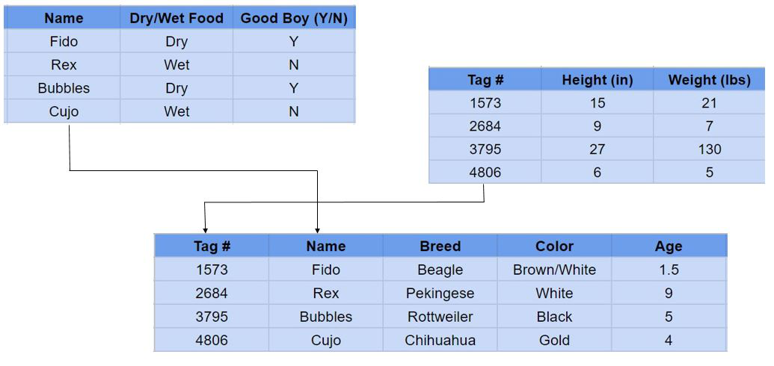
Introducing Relational Database
A database that follows the relational model and stores data in a tabular format is known as a relational database. The database has rows and columns and a unique key for each data point.
Examples:
Microsoft SQL Server, Oracle, MYSQL
Source:
https://media.geeksforgeeks.org/wp-content/uploads/20200427225738/RDBMS.png
Notes:
A relational database is a collection of data items with pre-defined relationships between them. These items are organized as a set of tables with columns and rows. Tables are used to hold information about the objects to be represented in the database.

Slide 19
Terminology in RDBMS
Table
Column
Relation
Tuples
Attributes
Degree
Cardinality
Domain
A table is a set of data represented by columns and rows.
Row
It is a combination of column values and is referred to as a record.
It is referred to as a field.
An individual piece of data in a record is known as a field, or attribute.
A single row of a table, which contains a single record for that relation
It defines database relationships in the form of tables.
A degree of relationship represents the number of entity types that associate in a relationship
It refers to the uniqueness of a column in a table.
It is a unique set of values permitted for an attribute in a table.
Notes:
Terminology in RDBMS
Table
A table is a set of data represented by columns and rows.
Row
It is a combination of column values and is referred to as a record.
Column
It is referred to as a field. A column is a vertical entity in a table that contains all information associated with a specific field in a table.
Relation
It defines database relationships in the form of tables.
Tuples
A single row of a table, which contains a single record for that relation
Attributes
An individual piece of data in a record is known as a field, or attribute.
Degree
A degree of relationship represents the number of entity types that associate in a relationship
Cardinality
It refers to the uniqueness of a column in a table.
Domain
It is a unique set of values permitted for an attribute in a table.

Slide 20
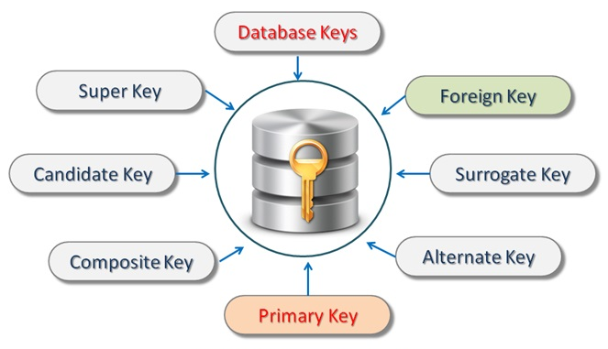
Types of RDBMS Keys
Source:
https://www.learncomputerscienceonline.com/database-keys/
Notes:
Types of RDBMS keys are
What is the Super key?
A superkey is a group of single or multiple keys which identifies rows in a table. A Super key may have additional attributes that are not needed for unique identification.
What is a Primary Key?
PRIMARY KEY in DBMS is a column or group of columns in a table that uniquely identify every row in that table. The Primary Key can’t be a duplicate meaning the same value can’t appear more than once in the table. A table cannot have more than one primary key.
Rules for defining Primary key:
Two rows can’t have the same primary key value
It must for every row to have a primary key value.
The primary key field cannot be null.
The value in a primary key column can never be modified or updated if any foreign key refers to that primary key.
What is the Alternate key?
ALTERNATE KEYS is a column or group of columns in a table that uniquely identify every row in that table. A table can have multiple choices for a primary key but only one can be set as the primary key. All the keys which are not primary key are called an Alternate Key.
What is a Candidate Key?
CANDIDATE KEY in SQL is a set of attributes that uniquely identify tuples in a table. Candidate Key is a super key with no repeated attributes. The Primary key should be selected from the candidate keys. Every table must have at least a single candidate key. A table can have multiple candidate keys but only a single primary key.
Properties of Candidate key:
It must contain unique values
Candidate key in SQL may have multiple attributes
Must not contain null values
It should contain minimum fields to ensure uniqueness
Uniquely identify each record in a table
What is the Foreign key?
FOREIGN KEY is a column that creates a relationship between two tables. The purpose of Foreign keys is to maintain data integrity and allow navigation between two different instances of an entity. It acts as a cross-reference between two tables as it references the primary key of another table.
What is the Composite key?
COMPOSITE KEY is a combination of two or more columns that uniquely identify rows in a table. The combination of columns guarantees uniqueness, though individually uniqueness is not guaranteed. Hence, they are combined to uniquely identify records in a table.
What is a Surrogate key?
SURROGATE KEYS is An artificial key which aims to uniquely identify each record is called a surrogate key. This kind of partial key in dbms is unique because it is created when you don’t have any natural primary key. They do not lend any meaning to the data in the table. Surrogate key in DBMS is usually an integer. A surrogate key is a value generated right before the record is inserted into a table.

Slide 21
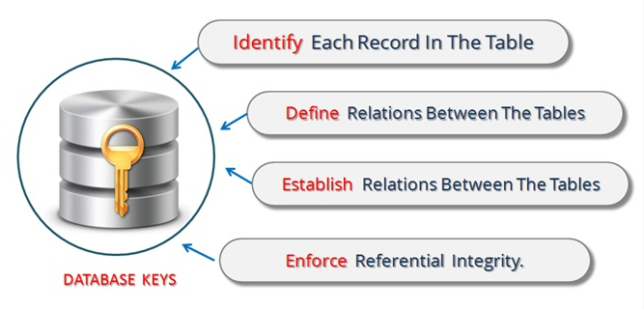
What is use of Database Keys ?
Source:
https://www.learncomputerscienceonline.com/database-keys/
Notes:
What is use of Database Keys ?
Keys play an important role in the relational database.
It is used to uniquely identify any record or row of data from the table. It is also used to establish and identify relationships between tables.
For example, ID is used as a key in the Student table because it is unique for each student. In the PERSON table, passport_number, license_number, SSN are keys since they are unique for each person.

Slide 22
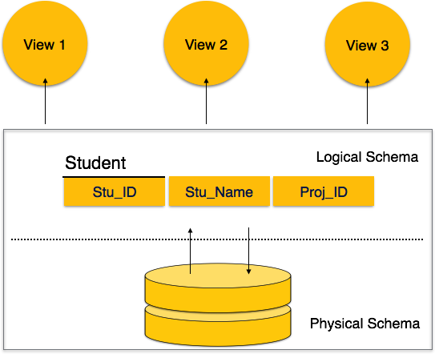
Database Schema and Schema Design
Source:
https://www.tutorialspoint.com/dbms/dbms_data_schemas.htm
Notes:
Database Schema
A database schema is the skeleton structure that represents the logical view of the entire database. It defines how the data is organized and how the relations among them are associated. It formulates all the constraints that are to be applied on the data.
A database schema defines its entities and the relationship among them. It contains a descriptive detail of the database, which can be depicted by means of schema diagrams. It’s the database designers who design the schema to help programmers understand the database and make it useful.
A database schema can be divided broadly into two categories −
Physical Database Schema − This schema pertains to the actual storage of data and its form of storage like files, indices, etc. It defines how the data will be stored in a secondary storage.
Logical Database Schema − This schema defines all the logical constraints that need to be applied on the data stored. It defines tables, views, and integrity constraints.

Slide 23
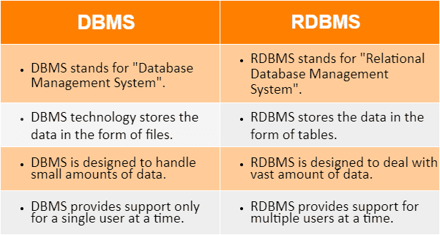
DBMS vs RDBMS
Source:
https://www.tutorialsmate.com/2021/02/difference-between-dbms-and-rdbms.html
Notes:
DBMS vs RDBMS
DBMS stands for “Database Management System” whereas RDBMS stands for “Relational Database Management System”.
DBMS technology stores the data in the form of files vs RDBMS stores the data in the form of tables.
DBMS is designed to handle small amounts of data whereas RDBMS is designed to deal with vast amount of data.
DBMS provides support for a single user at a time whereas RDBMS provides support for multiple users at a time.

Slide 24
Structured Query Language (SQL)
SQL is a language used for interacting with Relational Database Management System (RDBMS)
You can use SQL to get the RDBMS to :
Create, retrieve, update & delete data
Create & manage databases
Design & create databases tables
Perform administration tasks (security, user management, import/export etc.)
Notes:
SQL is a language used for interacting with Relational Database Management System (RDBMS)
You can use SQL to get the RDBMS to :
Create, retrieve, update & delete data.
Create & manage different databases.
Design & create databases tables : We can define like a database schema which would just be like the overall like table design.
Perform administration tasks (security, user management, import/export etc.)

Slide 25
MYSQL
Notes:
Let's discuss about MySQL

Slide 26
What is MySQL?
MySQL is released under an open-source license.
MySQL works on many operating systems and with many languages including PHP, PERL, C, C++, JAVA, etc.
MySQL works very quickly and works well even with large data sets.
MySQL supports large databases, up to 50 million rows or more in a table.
MySQL is customizable. The open-source GPL license allows programmers to modify the MySQL software to fit their own specific environments.
Notes:
What is MySQL?
MySQL is an open-source relational database management system. As with other relational databases, MySQL stores data in tables made up of rows and columns. Users can define, manipulate, control, and query data using Structured Query Language, more commonly known as SQL.

Slide 27
Lab 5: Installation of DBMS Software
Notes:
We have discussed what is DBMS. Now, let’s bring action to the words. Let’s install a DBMS software. Understand how to select the correct DBMS software. To day, we are going to install MySQL.

Slide 28
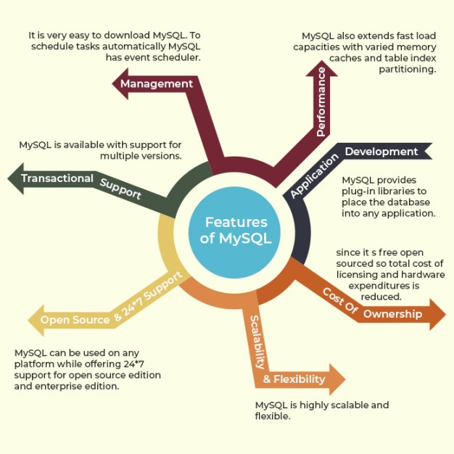
Features of MySQL
Speed
Ease of use
Cost
Query Language Support
Capability
Connectivity and security
Portability
Source:
https://i2.wp.com/d3d2ir91ztzaym.cloudfront.net/uploads/2020/06/Features-of-MySQL.jpg
Notes:
Features of MySQL
Speed: Of course, the speed at which a server-side program runs depends primarily on the server hardware. Given that the server hardware is optimal, MySQL runs very fast. It supports clustered servers for demanding applications.
Ease of use: MySQL is a high-performance, relatively simple database system. From the beginning, MySQL has typically been configured, monitored, and managed from the command line. However, several MySQL graphical interfaces are available as described below:
MySQL Administrator: This tool makes it possible for administrators to set up, evaluate, and tune their MySQL database server. This is intended as a replacement for mysqladmin.
MySQL Query Browser: Provides database developers and operators with a graphical database operation interface. It is especially useful for seeing multiple query plans and result sets in a single user interface.
Configuration Wizard: Administrators can choose from a predefined list of optimal settings, or create their own.
MySQL System Tray: Provides Windows-based administrators a single view of their MySQL instance, including the ability to start and stop their database servers.
Cost: MySQL is available free of cost. MySQL is an "Open Source" database. MySQL is part of LAMP (Linux, Apache, MySQL, PHP / Perl / Python) environment, a fast-growing open-source enterprise software stack. More and more companies are using LAMP as an alternative to expensive proprietary software stacks because of its lower cost, reliability, and documentation.
Query Language Support: MySQL understands standards-based SQL (Structured Query Language).
Capability: Many clients can connect to the server at the same time. Clients can use multiple databases simultaneously. You can access MySQL using several interfaces such as command-line clients, Web browsers.
Connectivity and security: MySQL are fully networked, and database can be accessed from anywhere on the Internet, so you can share your data with anyone, anywhere. The connectivity could be achieved with Windows programs by using ODBC drivers. By using the ODBC connector to MySQL, any ODBC-aware client application (for example, Microsoft Office, report writers, Visual Basic) can connect to MySQL.
Portability: MySQL runs on many varieties of UNIX, as well as on other non-UNIX systems, such as Windows and OS/2. MySQL runs on hardware from home PCs to high-end server. MySQL can be installed on Windows XP, Windows Server 2003, Red Hat Fedora Linux, Debian Linux, and others.

Slide 29
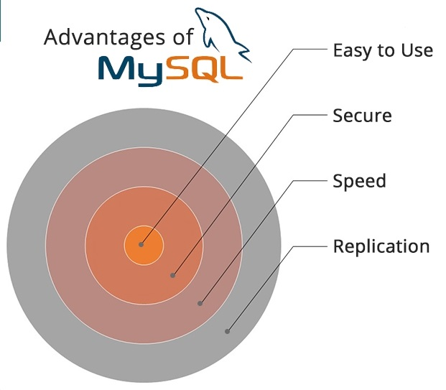
Benefits of MySQL
Flexible and easy to use
High performance
A mature DBMS
Secure database
Free installation
Simple syntax
Source:
https://www.janbasktraining.com/blog/uploads/images/image_750x_5dcd28ff0dfd4.jpg
Notes:
Benefits of MySQL
Flexible and easy to use: Modify source code according to your own needs and expectations. The installation process is relatively simple, and doesn’t take much time.
High performance: Even if you are storing massive amounts of big e-Commerce data or doing heavy business intelligence activities, MySQL can assist you smoothly with optimum speed.
A mature DBMS: Developers have been using MySQL for years, which means that there are abundant resources for them. It has evolved over the years and has very little margin for any kind of bugs.
Secure database: Data security is the basic need of every web app. With its Access Privilege System and User Account Management, MySQL sets the security bar high. It offers both Host-based verification and password encryption as well.
Free installation: The community edition of MySQL is free to download. There are some prepaid options but if your company is too small to pay for them, the free-to-download model is the most suitable for a fresh start.
Simple syntax: MySQL’s structure very simple and plain. That’s why developers even consider MySQL a database with a human-like language. MySQL is easy to use, most of the tasks can be executed right in the command line, reducing development steps

Slide 30

Cons of MySQL
Owned by Oracle
Scalability issues
Limited support for SQL standards
Large databases
Tools
Data Corruption
Notes:
Cons of MySQL
Owned by Oracle: MySQL used to be open source but now its not completely open source. It’s mostly now under Oracle’s license which limits the MySQL community in terms of improving the DBMS.
Scalability issues: MySQL is not as efficiently scalable as the NoSQL database. It will need more engineering effort to make it scalable. So, if you have apps for which your database will increase substantially, you should choose another DBMS option.
Limited support for SQL standards: MySQL doesn’t completely compliance with SQL standards. It does not provide support for some standard SQL features as well as it has some extensions and features that don’t match the Structured Query Language standards.

Slide 31
Lab 6: Creating the First Database
Notes:
So, let’s create our first database. We will understand how to design schema of a database. So, let’s go with the hands-on.

Slide 32
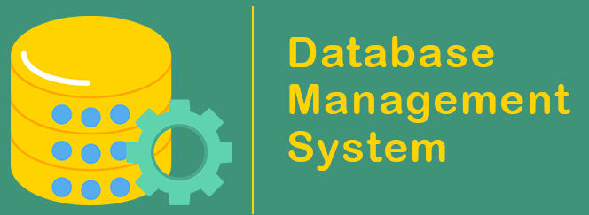
Tables in DBMS
In a Database Management System (DBMS), tables are the fundamental structures used to organize and store data.
Tables are often referred to as relations, and they play a crucial role in defining the schema of a database.
Source:
https://www.javatpoint.com/dbms-full-form
Notes:
In a Database Management System (DBMS), tables are the fundamental structures used to organize and store data.
Tables are often referred to as relations, and they play a crucial role in defining the schema of a database.

Slide 33
Lab 7: Creating Tables in Database
Notes:
An empty database would have no meaning. A database may have different tables. Let’s create some databases in a table.

Slide 34
Keys in DBMS
In DBMS, keys are important concepts that play a crucial role in:
Defining the relationships between tables
Ensuring data integrity
Facilitating efficient data retrieval
Source:
https://www.javatpoint.com/dbms-full-form
Notes:
In a Database Management System (DBMS), keys are important concepts that play a crucial role in defining the relationships between tables, ensuring data integrity, and facilitating efficient data retrieval.

Slide 35
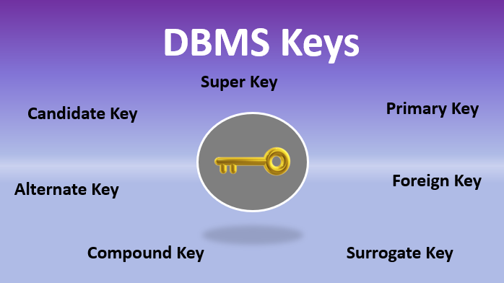
Different Keys in DBMS
Source:
https://www.educba.com/dbms-keys/
Notes:
There are Different types of keys in DBMS, Some of the important ones are:
Primary Key (PK): A primary key is a unique identifier for each row in a table. It ensures that each record in the table is distinct and can be uniquely identified. Primary keys are used to enforce data integrity and prevent duplicate entries. Typically, primary keys are chosen from existing attributes in the table, such as an employee ID or a product code.
Foreign Key (FK): A foreign key is a column (or a set of columns) in one table that refers to the primary key in another table. Foreign keys establish relationships between tables. They help maintain data integrity by ensuring that data in related tables remains consistent. For instance, in a "Orders" table, the "CustomerID" column could be a foreign key referencing the "Customers" table.
Unique Key: Similar to a primary key, a unique key ensures that the values in a column (or set of columns) are unique. However, unlike a primary key, a table can have multiple unique keys. Unique keys are used to prevent duplicate values in a column that is not the primary key.
Candidate Key: A candidate key is a set of attributes that can uniquely identify a tuple (row) in a table. It can potentially be chosen as the primary key. Each candidate key has the property that no subset of its attributes can uniquely identify a tuple.
Super Key: A super key is a set of one or more attributes that can uniquely identify a tuple. It may or may not be minimal, meaning it might have redundant attributes that can be removed without losing the uniqueness property.
Composite Key: A composite key is a key that consists of two or more attributes. Together, these attributes can uniquely identify a record, even if individually they might not be unique.
Surrogate Key: A surrogate key is a synthetic key that is generated by the DBMS rather than using natural attributes. It's often an auto-incrementing number. Surrogate keys are useful when there is no suitable natural key or when maintaining privacy is a concern.
Keys are essential in maintaining the integrity of the data stored in a database. They enable the establishment of relationships between tables, enforce uniqueness, and ensure accurate data representation.

Slide 36
Lab 8: Use of Different Keys
Notes:
In a table, you establish relations between different columns. A key helps to unique identify a row. Let’s have some practical understanding of different keys in DBMS. So, without losing anymore time, let’s start the hands-on session.

Slide 37
Categories of SQL Statements
DDL (Data Definition Language):
DDL statements are used to alter/modify a database or table structure and schema. These statements handle the design and storage of database objects.
CREATE – create a new Table, database, schema
ALTER – alter existing table, column description
DROP – delete existing objects from database
Notes:
Data Definition Language or DDL commands in SQL are used for changing the structure of a table. In other words, DDL commands are capable of creating, deleting, and modifying data.

Slide 38
Categories of SQL Statements
DML (Data Manipulation Language):
These are basic operations we perform on data such as selecting a few records from a table, inserting new records, deleting unnecessary records, and updating/modifying existing records.
SELECT - select records from a table
INSERT - insert new records
UPDATE - update/Modify existing records
DELETE - delete existing records
Notes:
The DML or Data Manipulation Language commands help in modifying a relational database. These commands are not auto-committed, which simply means that all changes made to the database using DML commands aren’t automatically saved.

Slide 39
Categories of SQL Statements
DCL (Data Control Language):
DCL statements control the level of access that users have on database objects.
GRANT - allows users to read/write on certain database objects
REVOKE - keeps users from read/write permission on database objects
Notes:
DCL is the abstract of Data Control Language. Data Control Language includes commands such as GRANT, and is concerned with rights, permissions, and other controls of the database system. DCL is used to grant/revoke permissions on databases and their contents.

Slide 40
Categories of SQL Statements
TCL (Transaction Control Language)
TCL statements allow you to control and manage transactions to maintain the integrity of data within SQL statements.
BEGIN Transaction - opens a transaction
COMMIT Transaction - commits a transaction
ROLLBACK Transaction - ROLLBACK a transaction in case of any error
Notes:
Transaction Control Language commands can only be used with DML commands. As these operations are auto-committed in the database, they can’t be used while creating or dropping tables.

Slide 41
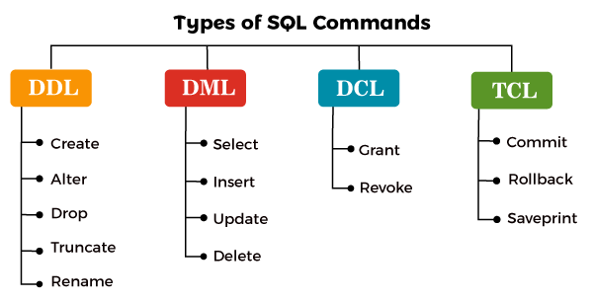
SQL Commands
Source:
https://static.javatpoint.com/sqlpages/images/types-of-sql-commands.png
Notes:
SQL commands are the instructions used to communicate with a database to perform tasks, functions, and queries with data. SQL commands can be used to search the database and to do other functions like creating tables, adding data to tables, modifying data, and dropping tables

Slide 42
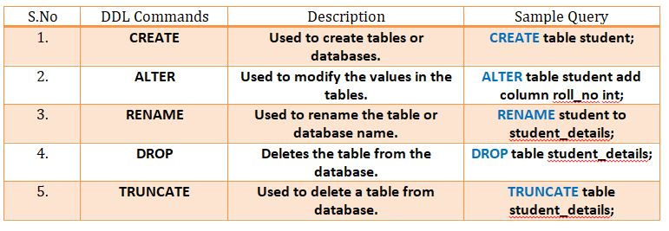
SQL Commands
Source:
https://minigranth.in/sql-tutorial/images/tutorials/SQL%20IMAGES/DDL%20Commands.jpg
Notes:
Data Definition Language (DDL) commands:
CREATE to create a new table or database.
ALTER for alteration.
RENAME to rename a table.
DROP to drop a table.
Truncate to delete data from the table.

Slide 43
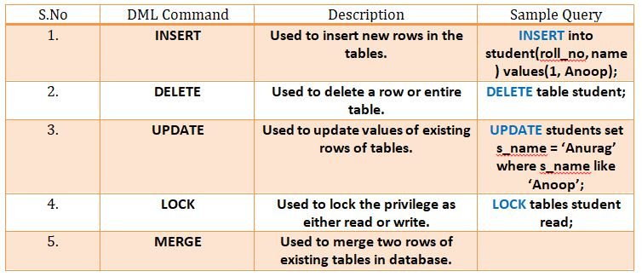
SQL Commands
Source:
https://minigranth.in/sql-tutorial/images/tutorials/SQL%20IMAGES/DML%20Commands.jpg
Notes:
List of DML commands:
INSERT : It is used to insert data into a table.
UPDATE: It is used to update existing data within a table.
DELETE : It is used to delete records from a database table.
LOCK: Table control concurrency.

Slide 44
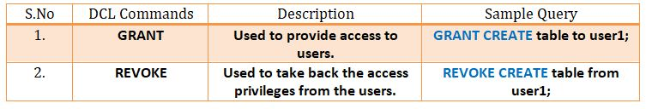
SQL Commands
Source:
https://minigranth.in/sql-tutorial/images/tutorials/SQL%20IMAGES/DCL%20Commands.jpg
Notes:
Data control language (DCL) is used to access the stored data. It is mainly used for revoke and to grant the user the required access to a database. In the database, this language does not have the feature of rollback. It is a part of the structured query language (SQL).

Slide 45
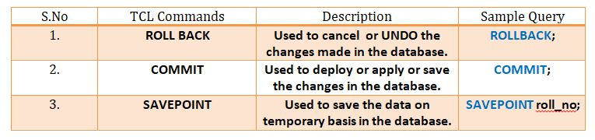
SQL Commands
Source:
https://minigranth.in/sql-tutorial/images/tutorials/SQL%20IMAGES/TCL%20Commands.jpg
Notes:
List of TCL commands:
COMMIT: Commits a Transaction.
ROLLBACK: Rollbacks a transaction in case of any error occurs.
SAVEPOINT:Sets a savepoint within a transaction.

Slide 46
Lab 9: CRUD operations
Notes:
CRUD means Create, Retrieve, Update and Delete. DBMS offers queries of different types. Let’s practice these operations and understand where to use what in this hands-on session.

Slide 47
Summary
DBMS helps to achieve efficient data management, data integrity and reliability.
Relational Database Management System (RDBMS) is a software that organizes and manages data in a structured way using tables with predefined relationships.
MySQL is an open-source Relational Database Management System (RDBMS) known for its speed and reliability in managing structured data.
Notes:
Summary
DBMS helps to achieve efficient data management, data integrity and reliability.
Relational Database Management System (RDBMS) is a software that organizes and manages data in a structured way using tables with predefined relationships.
MySQL is an open-source Relational Database Management System (RDBMS) known for its speed and reliability in managing structured data.

Slide 48

Quiz
1. In a relational database, what is a primary key used for?
Storing large binary data
Establishing relationships between tables
Sorting data within a table
Uniquely identifying each row in a table
Answer: d
Uniquely identifying each row in a table

Slide 49
Quiz
2. Which of the following is NOT a primary role of a Database Management System (DBMS)?
a) Data storage
b) Data retrieval
c) User interface design
d) Data manipulation
Answer: c
User interface design

Slide 50
Quiz
3. What is the purpose of SQL (Structured Query Language)?
a) To design user interfaces
b) To manage hardware components
c) To manage and manipulate databases
d) To create graphical elements
Answer: c
To manage and manipulate databases

Slide 51
Reference
DBMS Tutorial | What is a Database Management System? - javatpoint
Introduction to Database (w3schools.in)
https://www.mysql.com/
Introduction to SQL Fundamentals (thoughtco.com)

Slide 52
Thank You

